Slide 1


Pollex
Team EliteByte
Team Members
Aaditya Mishra Saurav Singh
Komal Singh
Bajrang Gaur

Slide 2



Problem Statement
Common platform for polling/voting
There is no unique & special platform where an organization or user can get some response from people around them about what they think about a specific topic. For example - one can ask which one is your favorite programming language and get responses accordingly.
Idea theme
Quizing
Sports

Slide 3

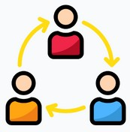


Our Solution
We are here with a common platform where users or organizations can create polls and get responses.
Users can view ongoing polling trends in a variety of fields i.e. entertainment, tech, sports, and politics.
Apart from that, there will be a special section for sports where users can bet on different polls and win accordingly.
Users can make connections with people around the world.
Target users
Organization
Individual
Content creators

Slide 4




App features
Polling
Users can create simple single-choice, multiple-choice, ranking, and descriptive polls.
Connectivity
Get responses from people all over the world instead of a small group of people.
Others
Easy to use
Interactive user interface
Sports
Bet to polls that are based on current trends and win prizes

Slide 5
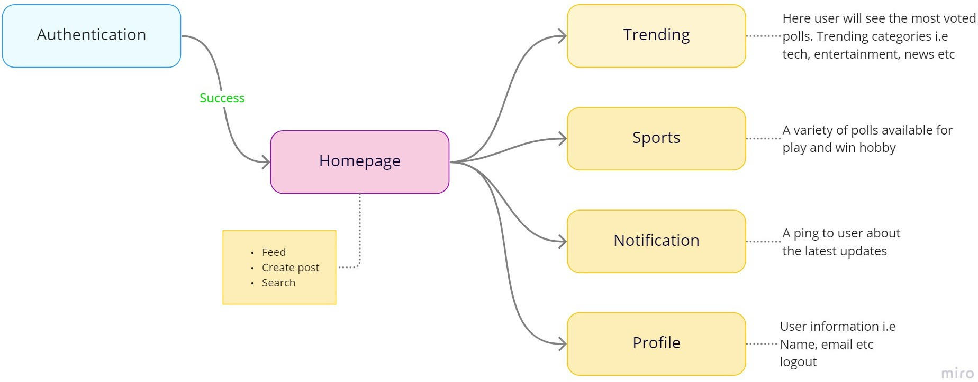
Userflow

Slide 6

Revenue model
AdSense
This will be our primary source of income. We will show ads on the app and get revenue.
Commision
For every winning prize in the sports section, we will have some commission on it.
Marketing
To boost the poll generated by users, there will be some charges.

Slide 7


Techstack
Flutter
For creating the frontend of the app
Firebase
For connecting the backend

Slide 8

Thank you

